Slide 1








Click Here to View Additional/Optional Slides
Presented by | TEAM IVORY
Previa
YOUR FINANCIAL HEALTH PARTNER
Transforming Financial Stress into Financial Confidence
Click Here to View the Interactive Pitch Deck

Slide 2

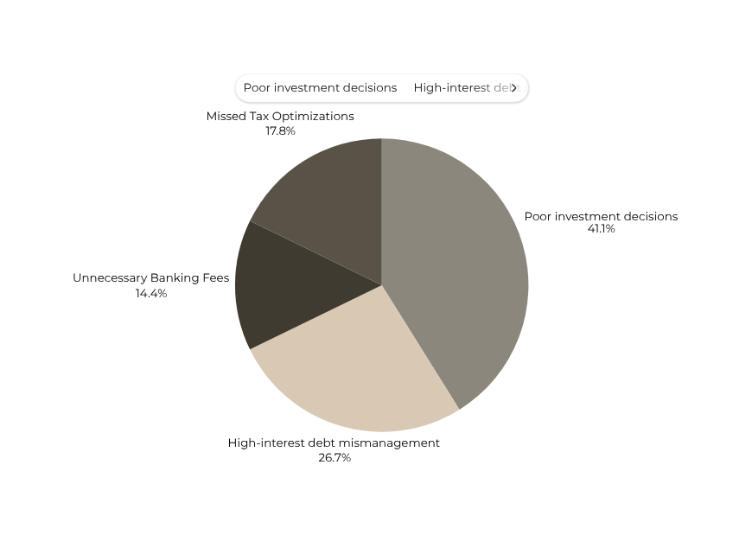
Previa
Team Ivory Production
YOUR FINANCIAL HEALTH PARTNER
The Financial Health Crisis
45
of Australians are financially illiterate costing $7,381 annually
$1,850 lost to poor investment decisions
$1,200 to high-interest debt mismanagement
$650 in unnecessary banking fees
$800 in missed tax optimizations
Page 2

Slide 3





Previa
Team Ivory Production
YOUR FINANCIAL HEALTH PARTNER
The Problem
$66 Billion
Time Drain : 5+ hours/week on manual financial admin
45
Knowledge Gap : 45% financially illiterate
Money Leaks: 26.5% have $0 left after payday
Page 3

Slide 4
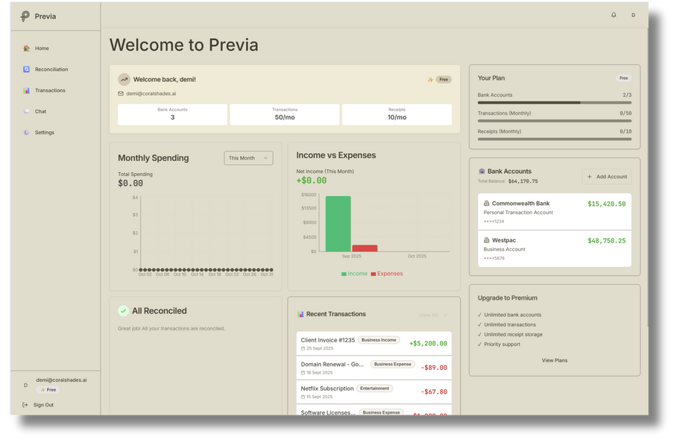
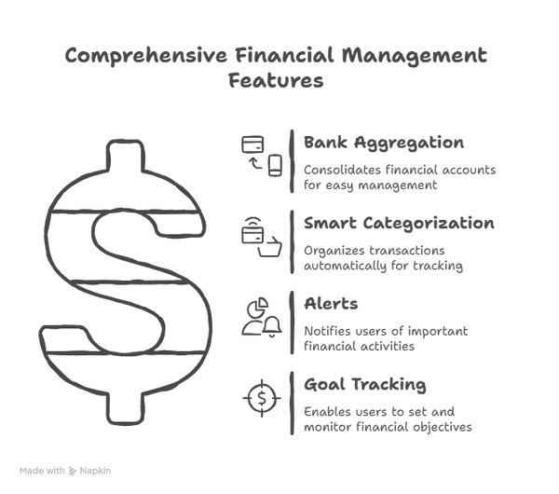


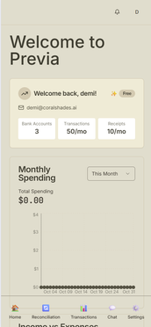
Previa
YOUR FINANCIAL HEALTH PARTNER
Introducing
Previa
YOUR FINANCIAL HEALTH PARTNER
Transforming Financial Stress into Financial Confidence
AI Coach
Automation
Gamified Learning
Page 4

Slide 5
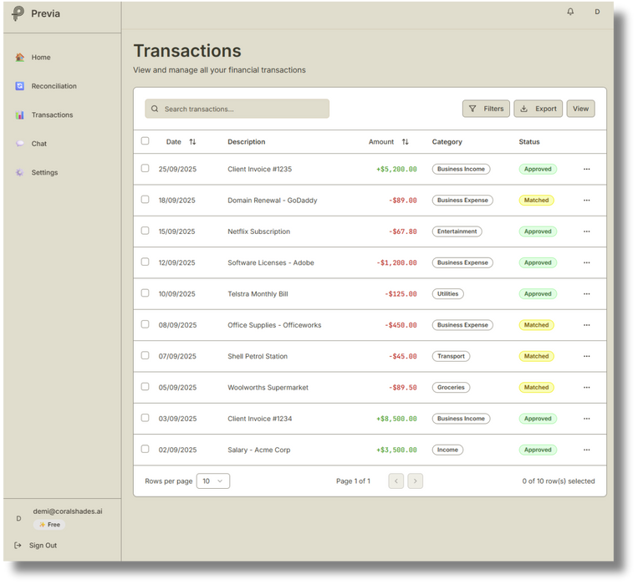
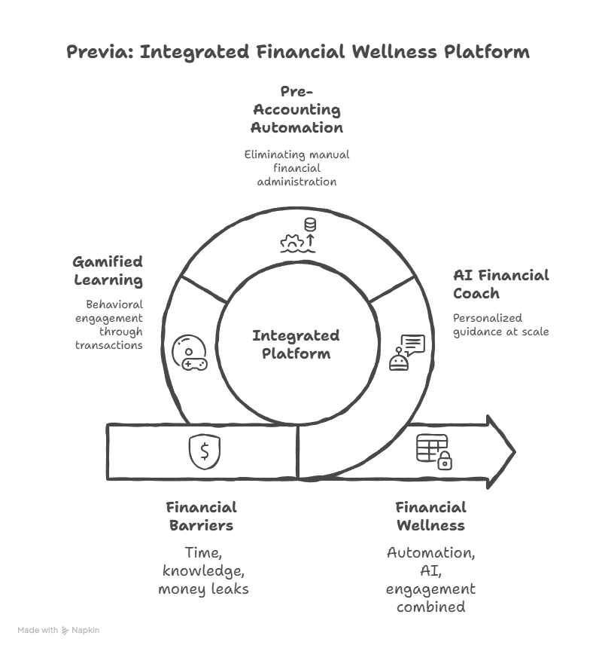

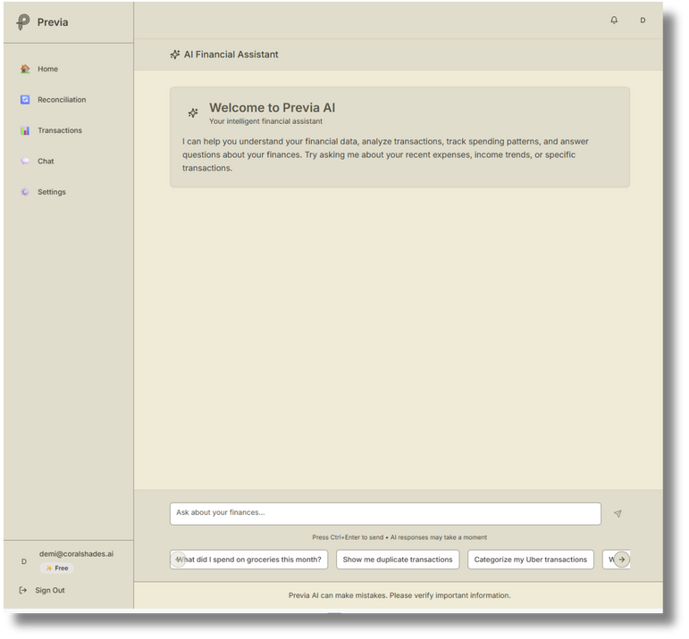

Previa
Team Ivory Production
YOUR FINANCIAL HEALTH PARTNER
How It Works
Receipt Scanning
Insights
Achievements
Page 5

Slide 6
Previa
Team Ivory Production
YOUR FINANCIAL HEALTH PARTNER
Market Opportunity & trends
Australia’s Fintech Boom
• 58% of adults use at least one fintech platform
• Rising cost-of-living pressure drives demand for budgeting & cashflow tools
• AI adoption in finance up 45% YoY (2024–25)
• Government & ATO initiatives encourage digital compliance & open banking
TAM - 6.5M
SAM - 3.5M
SOM - 200K
Page 6

Slide 7
Previa
Team Ivory Production
YOUR FINANCIAL HEALTH PARTNER
Competitive landscape
Where Previa stands in Australia’s fintech ecosystem.
Competitor | Personal + Biz | AI Coach | Pre-Accounting | Gamification | Pricing
Xero/QuickBooks | Biz only | No | No | Limited | $25–60
PocketSmith | Personal only | No | No | No | Free
Cleo (UK/US) | Personal only | Yes | No | Youth focus | $5–10
Thriday (NAB) | Biz only | Partial | Yes | No | $25–60
Frollo
Previa | Both | Yes | Yes | Yes (30–55) | $9.99–49
Page 7

Slide 8
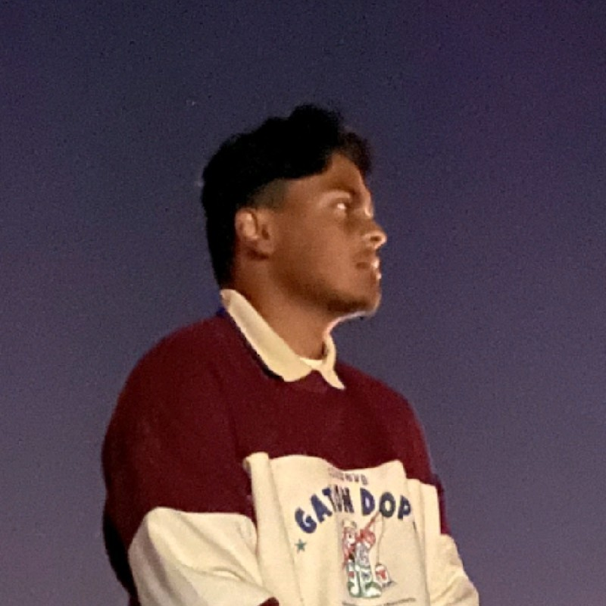

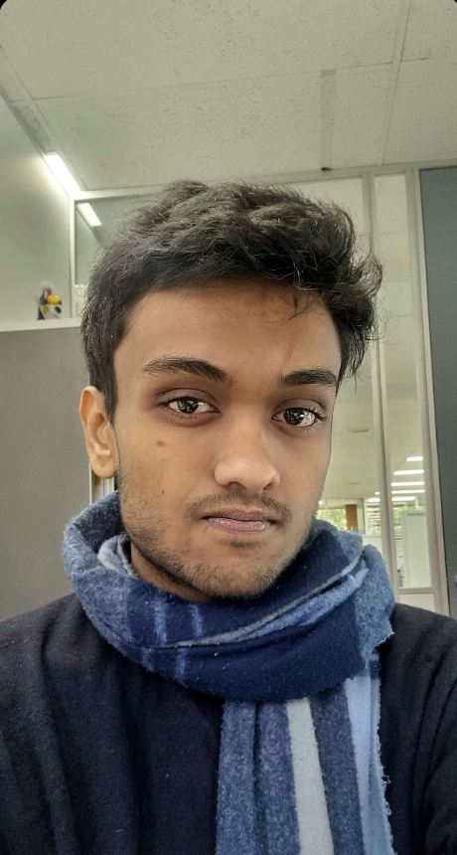
Previa
Team Ivory Production
YOUR FINANCIAL HEALTH PARTNER
Our Team
Minul Lokuliyana
Elton Lim
Wihithe “DEMI” Thathsara
Chief Product Officer,
Chief Commercial Officer
Chief Security Officer
C.E.O
Chief Technology Officer
Page 8

Slide 9
Previa
Team Ivory Production
YOUR FINANCIAL HEALTH PARTNER
Business Model & Revenue Streams
How Previa creates and captures value.
Free Tier
("Financial Health Free")
Premium Tier
("Financial Health+")
Business Tier
("Business Financial Intelligence")
Enterprise Tier ("Enterprise Financial Platform")
Pricing | Free + | AUD $14.99/mo 30 day free trial | AUD $29.99–39.99/mo 30 day free trial | Custom
Features | Basic aggregation 2 -3 Bank accounts Limited AI answers | Unlimited accounts Advanced coaching Family sharing. | Pre-accounting Tax Management Multi-user | Partner referrals SME bundles with banks
Partnership Integrations
Commissions from accounting/finance partners
White-label APIs for financial institutions (Previa engine integration)
Page 9

Slide 10
Previa
Team Ivory Production
YOUR FINANCIAL HEALTH PARTNER
GO-TO-MARKET (GTM) STRATEGY
How Previa will reach and retain users across Australia.
Phase 1: Alpha Launch (Months 1–6)
Alpha testing and refinement.
Target metrics: 40%+ users rate us 'very disappointed' if we disappeared, 20%+
DAU/MAU ratio
10+ paying commitments secured.
Phase 2: Growth (Months 6–12)
Public launch with enhanced AI capabilities,
Full gamification suite,
CDR integration via Basiq partnership —avoiding the $250K accreditation cost while maintaining speed to market.
Phase 3: Expansion (Year 2+)
Scale to 60-70K users,
Introduce Phase 2 business features for sole traders,
Expand bank integrations to all major Australian institutions.
Establish market leadership,
Prepare for international expansion starting with New Zealand.
Page 10

Slide 11
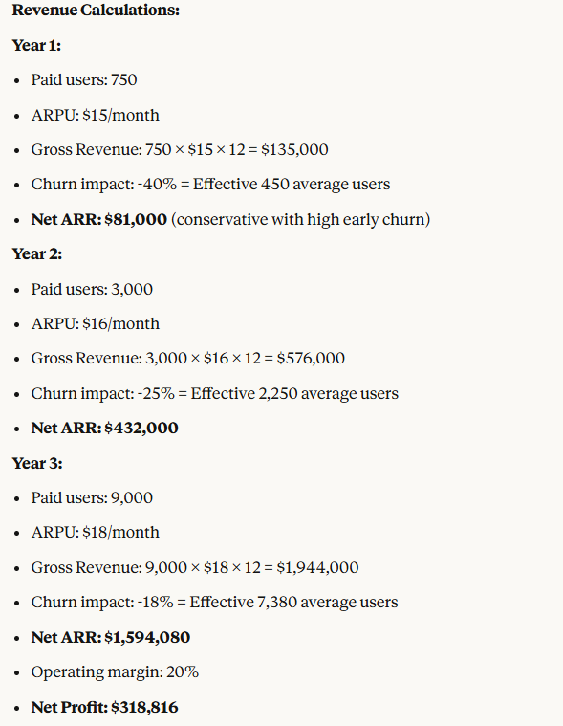
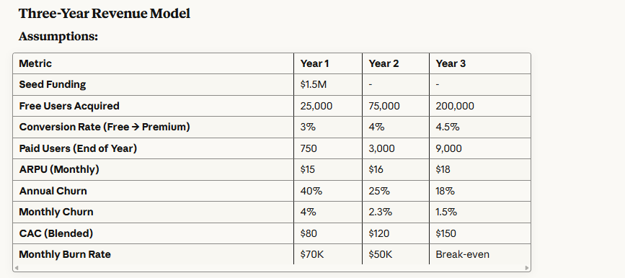
Previa
Team Ivory Production
YOUR FINANCIAL HEALTH PARTNER
Team Ivory Production
Previa
Your Financial Health Partner
Page 11

Slide 12
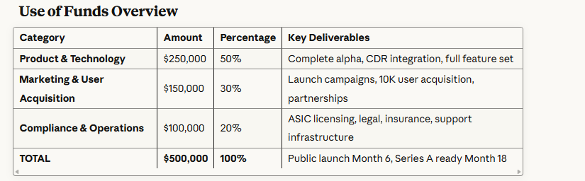
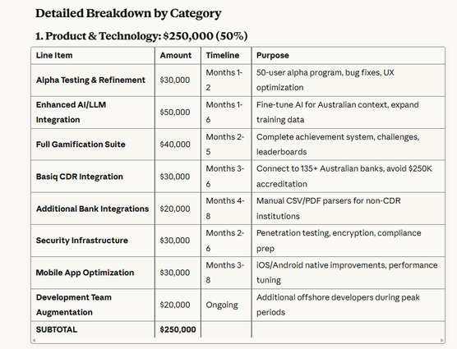
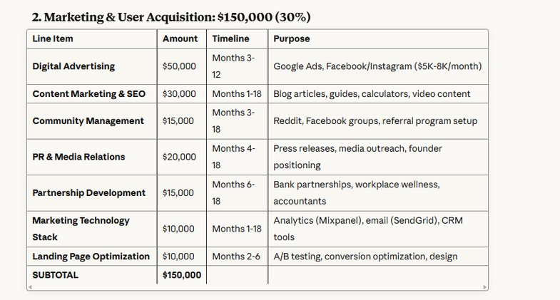
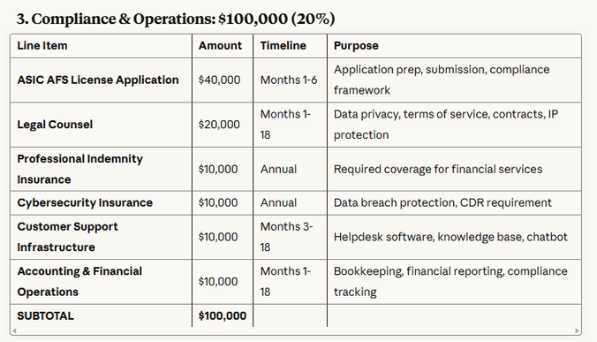
Previa
Team Ivory Production
YOUR FINANCIAL HEALTH PARTNER
Funding Ask & Use of Funds
SEEKING AUD $500K SEED / PRE-A FUNDING
Page 12

Slide 13
Previa
Team Ivory Production
YOUR FINANCIAL HEALTH PARTNER
THANK YOU
Q/A Time
Link To the App
Previa
YOUR FINANCIAL HEALTH PARTNER
Page 13

